Slide 1
Dr. Gayle Pitman, Associate Vice President of Institutional Equity, Effectiveness, and Success
Dr. Tracey Gomez, Dean of Student Equity and Pathways
Dr. Brian Lofman, Dean of Institutional Planning, Research, and Effectiveness
Dr. Layheng Ting, Institutional Research Analyst
HARTNELL COLLEGE
ENVIRONMENTAL SCAN 2023

Slide 2
OVERVIEW
What is an environmental scan?
An Environmental Scan is the identification and monitoring of factors from both inside and outside the organization that may impact planning and decision-making. It is an opportunity to gather a broad range of information to help determine the future direction of the district.
How was this environmental scan done?
There were three major components to this environmental scan:
External scan. Our external scan relied on a variety of data sources, including the U.S. Census and American Community Survey, the California Department of Education, the California Department of Finance, and regional reports. These sources gave us information about population changes, educational trends, household income, cost of living, Internet and computer access, transportation, and labor market and employment trends.
Internal scan. Our internal scan utilized our local data and focused on student access, progress, momentum, and completion trends, as well as post-graduation success.
SWOT analysis. A SWOT analysis was conducted in Fall 2022 with the Academic Senate, Associated Students of Hartnell College (ASHC), classified professionals, and senior leadership team members. These analyses gather input regarding the institution’s strengths, weaknesses, opportunities, and threats.
How will this environmental scan be used?
The information in this scan will help us determine our strategic planning priorities, as well as the direction our strategic enrollment management efforts. Information from the environmental scan can also be used for other planning efforts, and can help us be proactive in anticipating projected trends.

Slide 3
KEY FINDINGS - EXTERNAL SCAN

Slide 4
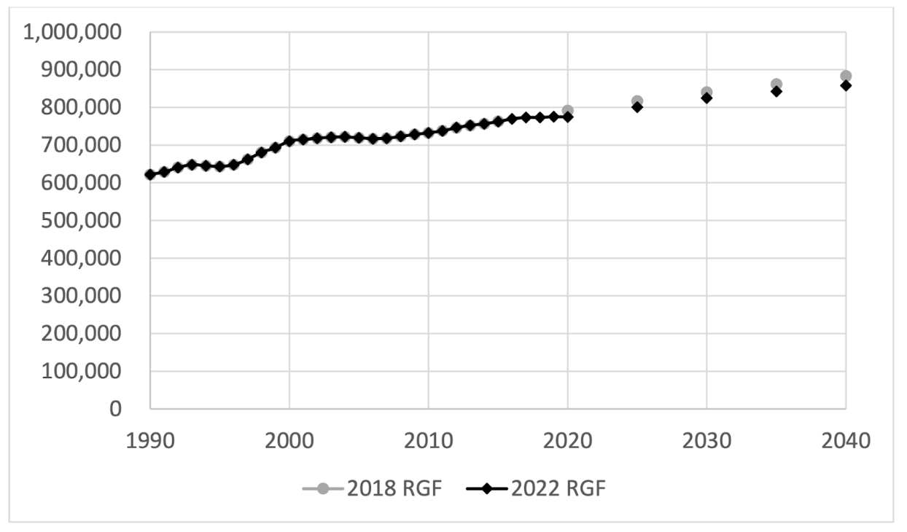
KEY FINDINGS - EXTERNAL SCAN
POPULATION
The population of Monterey County has been steadily growing since the 1990s, and is projected to continue to grow through 2040. (2022 Regional Growth Forecasts, Association of Monterey Bay Area Governments, June 2022)
2022 Regional Growth Forecast, Monterey County
All communities in Hartnell’s service area have a majority of Latino/a residents, with 79.8% in Salinas, 84.1% in Castroville, 76.4% in Soledad, and 87.1% in King City. Prunedale has the lowest percentage of Latino/a residents (52%) within Hartnell’s service area. (US Census Bureau QuickFacts)
Source: 2022 Regional Growth Forecasts, Association of Monterey Bay Area Governments, June 2022.
Spanish is the primary language in the majority of communities in Hartnell’s district. The highest percentages of Spanish-speaking residents are in the communities of Chualar (87.7%), King City (77.9%), Castroville (78.5%), and Salinas (73.4%). In the Salinas metropolitan area, 36.4% of residents reported speaking English “less than very well.” (American Community Survey 1-year estimates, Selected Social Characteristics in the United States, 2021)

Slide 5
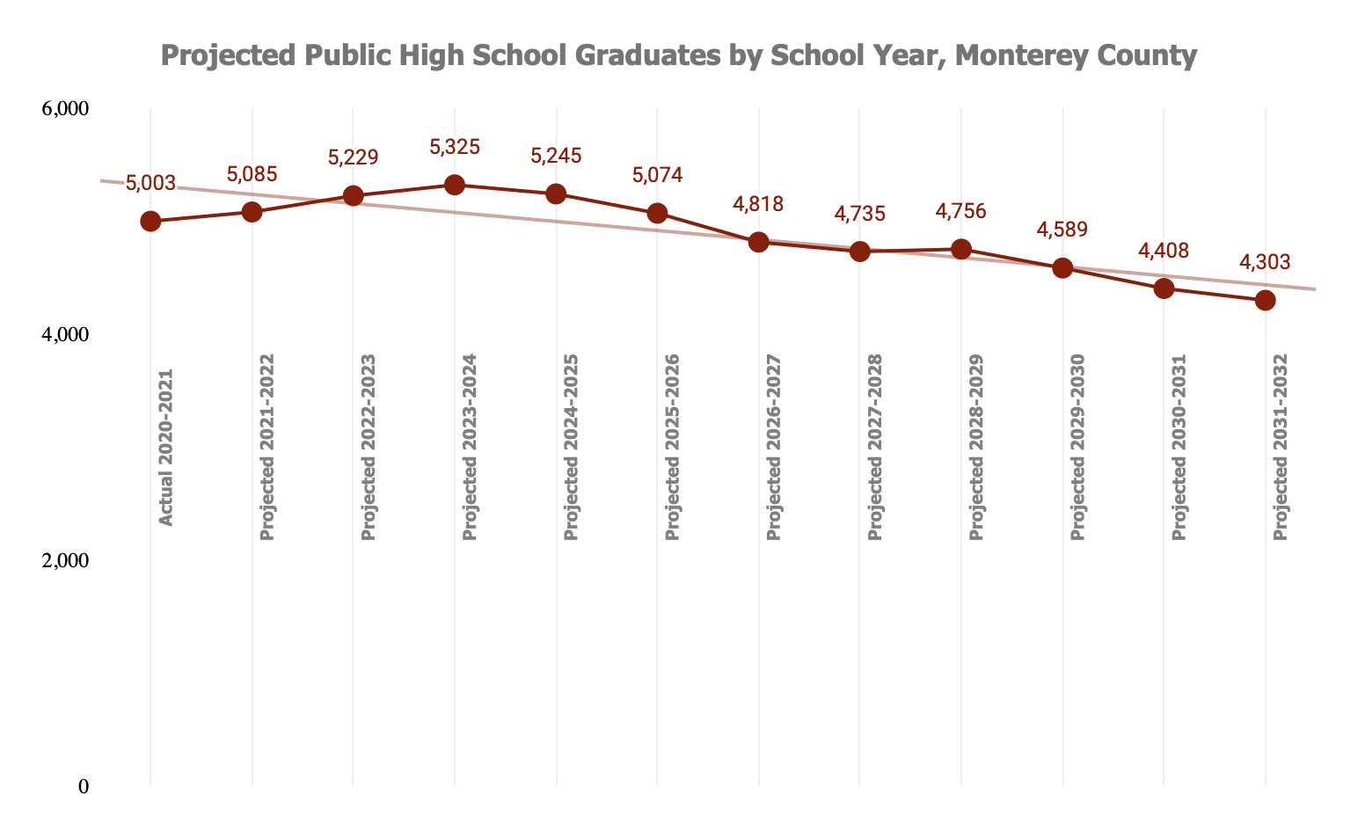
KEY FINDINGS - EXTERNAL SCAN
PROJECTED HIGH SCHOOL GRADUATES/COLLEGE-GOING RATES
The number of high school graduates in Monterey County will hit its peak at 5,325 in the 2023-2024 academic year. Projections indicate that these numbers will decline steadily for the next eight years, with a net loss of more than 1,000 graduates over that period of time. (California Department of Finance, Demographic Research Unit, September 2022)
The highest college-going rates are among students graduating from Gonzales Unified (69.3%) and Salinas Union High (66.3%). The lowest college-going rates are among students graduating from North Monterey County Unified (57.6%), Soledad Unified (62.0%), and South Monterey County Joint Union High (55.5%). As a comparison, the college-going rates in Monterey County are 63.3%, and 63.8% statewide. (DataQuest, California Department of Education)
Source: California Department of Finance, Demographic Research Unit, September 2022.

Slide 6
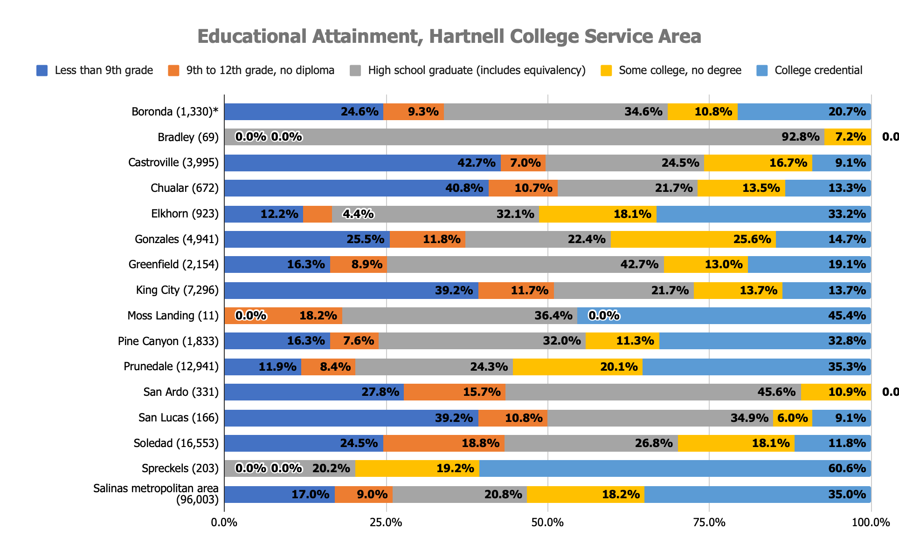
KEY FINDINGS - EXTERNAL SCAN
EDUCATIONAL ATTAINMENT
Among cities and CDPs with more than 500 residents over the age of 25, the communities of Castroville, Chualar, and King City have the highest percentages without a high school diploma (42.7%, 40.8%, and 39.2%, respectively).
Over 20% of residents 25 and older in the cities of Gonzales and Prunedale have some college but no degree (25.6% and 20.1%, respectively). In the city of Salinas, 18.2% of adults over 25 have some college but no degree.
Rates of baccalaureate degree attainment are significantly lower in the cities and CDPs of Castroville (5.2%), King City (8.8%), and Soledad (5.2%), compared to Salinas (15.7%). (US Census Bureau QuickFacts)
Source: American Community Survey 1-year estimates, Educational Attainment, 2021.
*Numbers in parentheses are the total number of residents 25 and older.

Slide 7
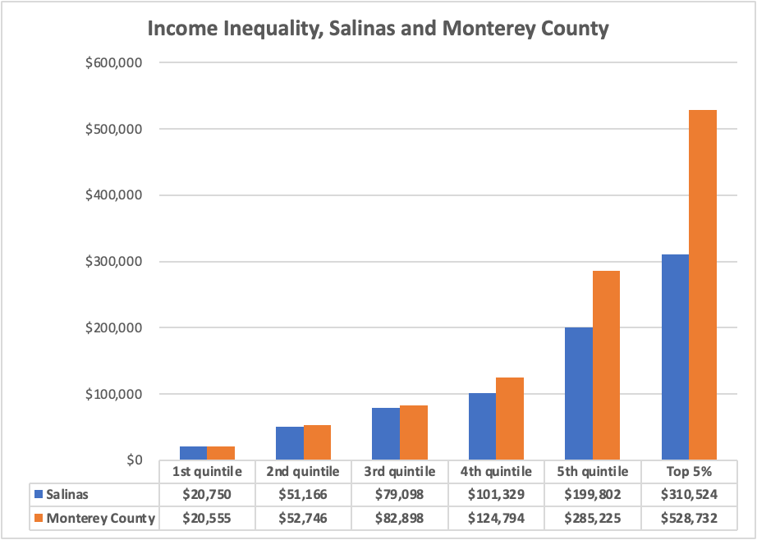
KEY FINDINGS - EXTERNAL SCAN
HOUSEHOLD CHARACTERISTICS AND INCOME DISPARITIES
Of Salinas, Soledad, King City, and Castroville, Soledad and Castroville have the highest average number of persons per household at 4.5 persons, while King City (4.2) and Salinas (3.8) are somewhat lower. Comparatively, persons per household in Monterey County (3.2) and the U.S. (2.6) are substantially lower.
Income inequality is substantial when comparing Salinas to Monterey County overall, growing considerably more dissimilar in moving from the lowest quintile to the top 5 percent of households. While the lowest quintile of mean household income is similar between the two ($20,750 vs. $20,555), the highest quintile of mean household income is much lower for Salinas ($199,802) than for Monterey County ($285,225). And the top 5 percent of households have a mean income of $310,524 for Salinas, compared with $528,732 for Monterey County. (Gini Index of Income Inequality, American Community Survey, US Census Bureau, 2021)
Source: Gini Index of Income Inequality, American Community Survey, US Census Bureau, 2021

Slide 8
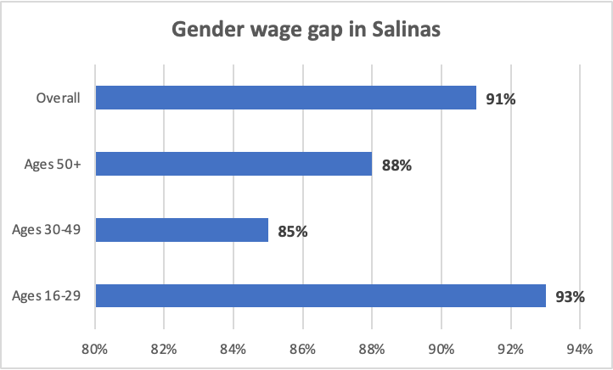
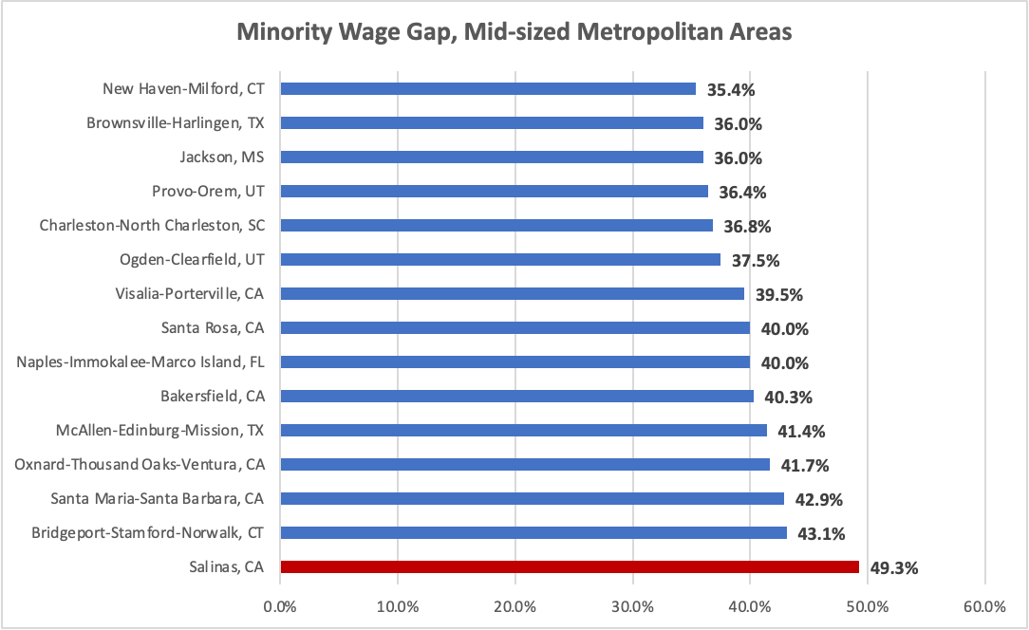
KEY FINDINGS - EXTERNAL SCAN
HOUSEHOLD CHARACTERISTICS AND INCOME DISPARITIES
Women aged 50 and above earned 88% of what men their age earned; women from 30-49 earned 85% of what men earned; and women in the 16-29 age bracket earned 93% of men, thereby representing the smallest age-based gender gap in pay. (Wage gap calculator, Pew Research)
Among mid-sized metropolitan areas in the U.S., Salinas has the largest wage gap (49.3%) between minority and non-minority (non-Hispanic white) full-time workers. (American Community Survey, US Census Bureau, 2021).
Source: Wage gap calculator, Pew Research Center
Source: American Community Survey, US Census Bureau, 2021)

Slide 9
KEY FINDINGS - EXTERNAL SCAN
COST OF LIVING AND LIVING WAGE
Poverty rates vary across Hartnell district locations: Soledad has the highest percentage of persons in poverty at 20.1%, while the percentages in Castroville (17.5%), King City (16.8%), and Salinas (14.35) are progressively lower, yet much higher than Monterey County overall (12.1%) and the U.S. (11.6%). (US Census Bureau Quickfacts, 2017-2021)
In the Salinas metropolitan area, there is a significant disparity between the minimum wage and the living wage, largely depending on the number of children in the household.One working adult with no children in the Salinas metropolitan area would have a poverty wage at $6.53, a minimum wage at $15.50, and a living wage at $22.02, whereas with three children these wages would be $13.34, $15.50, and $72.83, respectively. (Glasmeier, Amy K. Living Wage Calculator, 2023. Massachusetts Institute of Technology,https://livingwage.mit.edu)
Living Wage Calculation for Salinas, California
 | 1 ADULT |  |  |  | 2 ADULTS (1 WORKING) |  |  |  | 2 ADULTS (BOTH WORKING)
 | 0 children | 1 child | 2 children | 3 children | 0 children | 1 child | 2 children | 3 children | 0 children | 1 child | 2 children | 3 children
Living Wage | $22.02 | $41.73 | $53.38 | $72.83 | $32.24 | $39.80 | $44.76 | $52.70 | $15.83 | $22.99 | $28.64 | $36.20
Poverty Wage | $6.53 | $8.80 | $11.07 | $13.34 | $8.80 | $11.07 | $13.34 | $15.61 | $4.40 | $5.54 | $6.67 | $7.81
Minimum Wage | $15.50 | $15.50 | $15.50 | $15.50 | $15.50 | $15.50 | $15.50 | $15.50 | $15.50 | $15.50 | $15.50 | $15.50
Source: Glasmeier, Amy K. Living Wage Calculator, 2023. Massachusetts Institute of Technology,https://livingwage.mit.edu

Slide 10
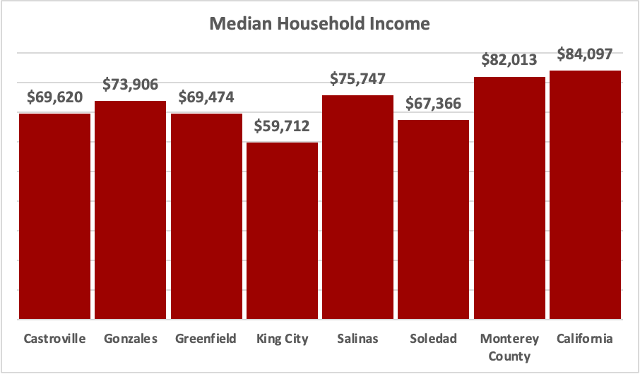
KEY FINDINGS - EXTERNAL SCAN
COST OF LIVING AND LIVING WAGE
Within Hartnell’s service area, median household income is lowest in King City ($59,712) and Soledad ($67,366). Median household income in the city of Salinas is $75,747, and $82,013 in Monterey County. (US Census Bureau QuickFacts, 2017-2021)
In order for a family in Salinas to earn a living wage,
Two working adults living with two children would need to receive an income before taxes of $119,155; with
Source: US Census Bureau QuickFacts, 2017-2021.
three children, that number rises to $150,609.
One working adult living with two children would need to earn $111,025; with three children, that number rises to $151,480.
Two adults with only one working and three children would need to earn $109,619. (Glasmeier, Amy K. Living Wage Calculator, 2023. Massachusetts Institute of Technology. https://livingwage.mit.edu)

Slide 11
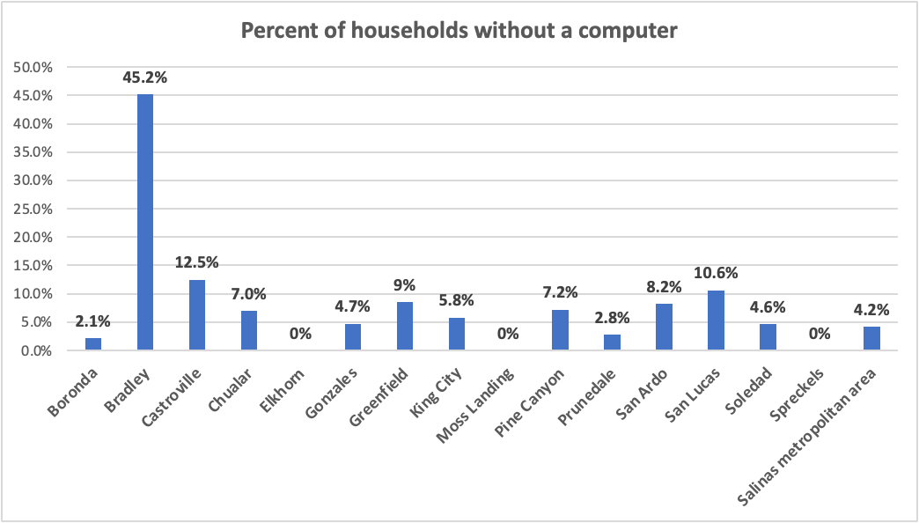
KEY FINDINGS - EXTERNAL SCAN
ACCESS TO COMPUTERS, SMARTPHONES, AND THE INTERNET
In general, people in CDPs and in South County, and in rural areas are much less likely to have access to a desktop or laptop. Whereas this figure is 84.8% for California and 78.7% for Monterey County, the percentage varies across cities from a high of 74.1 (Gonzales) to a low of 57.6% (King City), and across CDPs from highs of 100% (Spreckels) and 86.7% (Prunedale), to lows of 25.8% (San Lucas) and 25.9% (San Ardo). (American Community Survey, US Census Bureau, 2021)
Most people in Hartnell’s service area have access to a smartphone, from a low of 83.4% (Castroville) to a high of 100% (Spreckels). The highest percentages of people who rely solely on their smartphone for technology needs are in San Ardo (65.8%), San Lucas (63.6%), Castroville (35.4%), King City (31.5%), and Greenfield (29.7%).(American Community Survey, US Census Bureau, 2021)
CDPs and cities that have the highest estimated rates of people without access to any computing device include Castroville (12.5%), San Lucas (10.6%), Greenfield (8.5%), and San Ardo (8.2%).(American Community Survey, US Census Bureau, 2021)
Source: American Community Survey, US Census Bureau, 2021

Slide 12
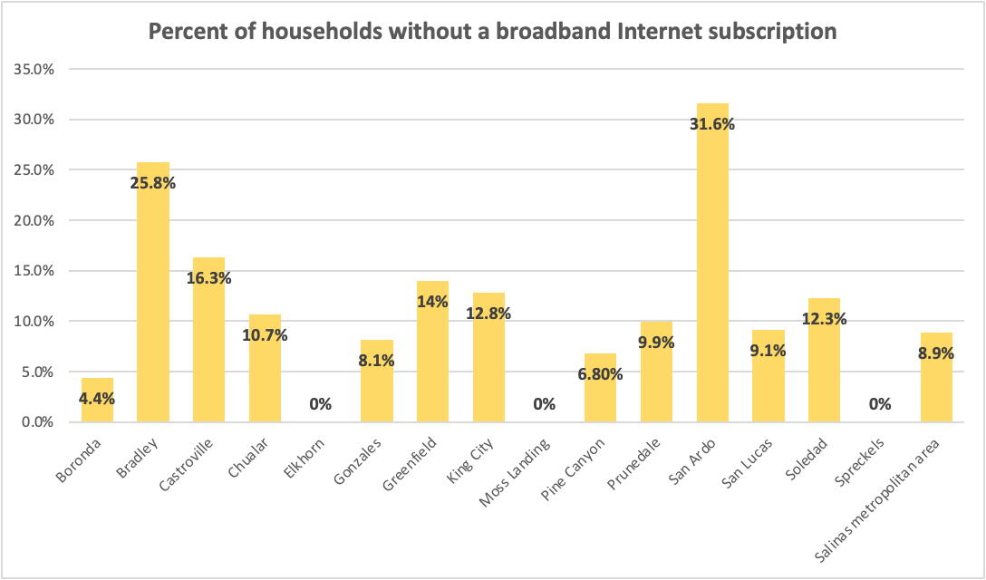
KEY FINDINGS - EXTERNAL SCAN
ACCESS TO COMPUTERS, SMARTPHONES, AND THE INTERNET
Within Hartnell’s service area, San Ardo has the lowest rate of internet access by far at 68.4%, while Castroville (83.7%), Greenfield (86.0%), Soledad (87.7%), King City (88.3%), and Chualar (89.3%) all have substantially higher figures but still lower than 90%. In the Salinas metropolitan area, 91.1% of households have a broadband Internet subscription. (American Community Survey, US Census Bureau, 2021)
For most CDPs and cities in the district, the estimated percentage of households without an internet subscription increases as income
Source: American Community Survey, US Census Bureau, 2021
decreases. The percentage for King City is 7.7% for households making $75,000 or more, 10.5% for households with incomes in the range of $20,000 to below $75,000, and 40.7% for households with less than $20,000. For Soledad, these figures are 5.8%, 15.8%, and 31.3%, respectively. The same applies for Greenfield (4.7%, 21.2%, 29.3%), Gonzales (0%, 15.4%, 19.3%), and Salinas (1.2%, 4.8%, 10.4%). And this pattern is demonstrated more broadly beyond the district in both Monterey County (2.9%, 7.6%, 18.6%) and California as a whole (2.6%, 9.2%, 21.3%).(American Community Survey, US Census Bureau, 2021)

Slide 13
KEY FINDINGS - EXTERNAL SCAN
TRANSPORTATION
Public transportation options to the educational centers are limited, although Hartnell students ride for free with their student identification.. The table below shows the frequency of each bus line from Salinas to each of our centers.
Bus Line | Route | Frequency
23 | Salinas to King City (includes Soledad) | Once every 30 mins (peak) Once every hour (off-peak)
28 | Salinas to Castroville | Once every 2 hours
47 | Salinas to Alisal | Once every hour
The estimated time for passengers to travel through the entire corridor on line 23 is 75 minutes, which has been considerably reduced from the previous 100 minutes. The 23 express currently provides a slightly faster transit time; staff are attempting to reduce the time to one hour.
Given staffing and other considerations, the Monterey-Salinas Transit board of directors determined that focusing on ridership over coverage would represent a more effective way of allocating resources moving forward, with the core allocation decision reflecting 40% Salinas, 40% Peninsula, and 20% the remainder of the county.

Slide 14
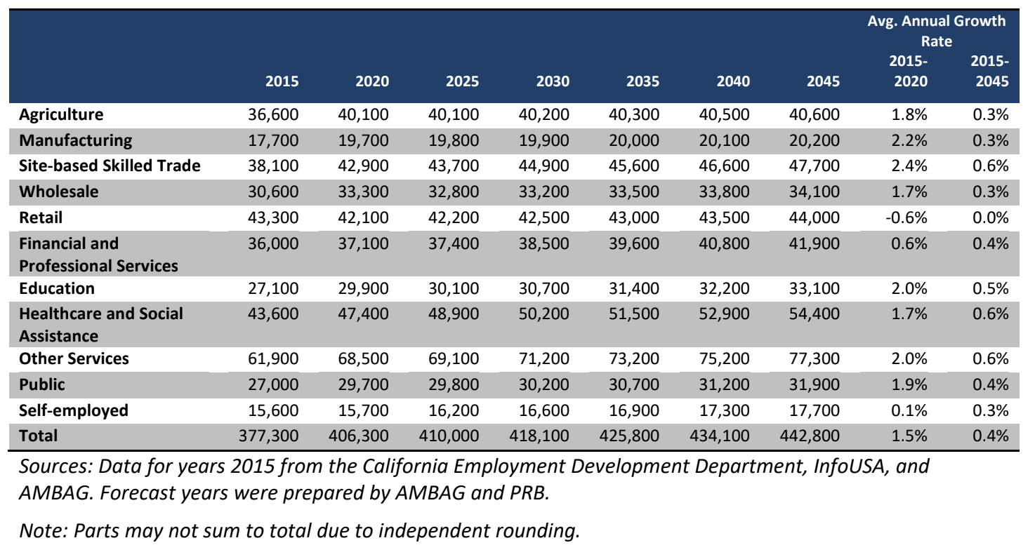
KEY FINDINGS - EXTERNAL SCAN
LABOR MARKET AND WORKFORCE NEEDS
Unemployment varies slightly across the three counties of Monterey, San Benito, and Santa Cruz. As of June 2023, the rate of unemployment (preliminary, not seasonally adjusted) was highest in San Benito at 5.8%, and lowest in Santa Cruz at 5.2%. Monterey County’s rate was 5.5%. (Employment Development Department, 2023)
Growth in the number of jobs from 2020 to 2040 is projected to be 15,538 to a total of 258,553 in 2040 for Monterey County; 10,117 to a total of 150,119 for Santa Cruz County; and 2,212 to a total of 25,475 for San Benito County. The percentage of job growth is projected to be in reverse order: 9.51% for San Benito, 7.23% for Santa Cruz, and 6.39% for Monterey. (Association of Monterey Bay Area Governments Regional Growth Forecast, 2022)
The highest percentages of job growth in Monterey County expected between 2020 and 2045 are in Health (14.8%), Finance/Professional Services (12.9%), Other Services (12.8%), and Self-Employed (12.7%). Although Agriculture is one of the largest industry sectors, it is expected to grow only 1.3% through 2045. (Association of Monterey Bay Area Governments Regional Growth Forecast, 2022)
Job Growth in Monterey County by Industry, 2015-2045

Slide 15
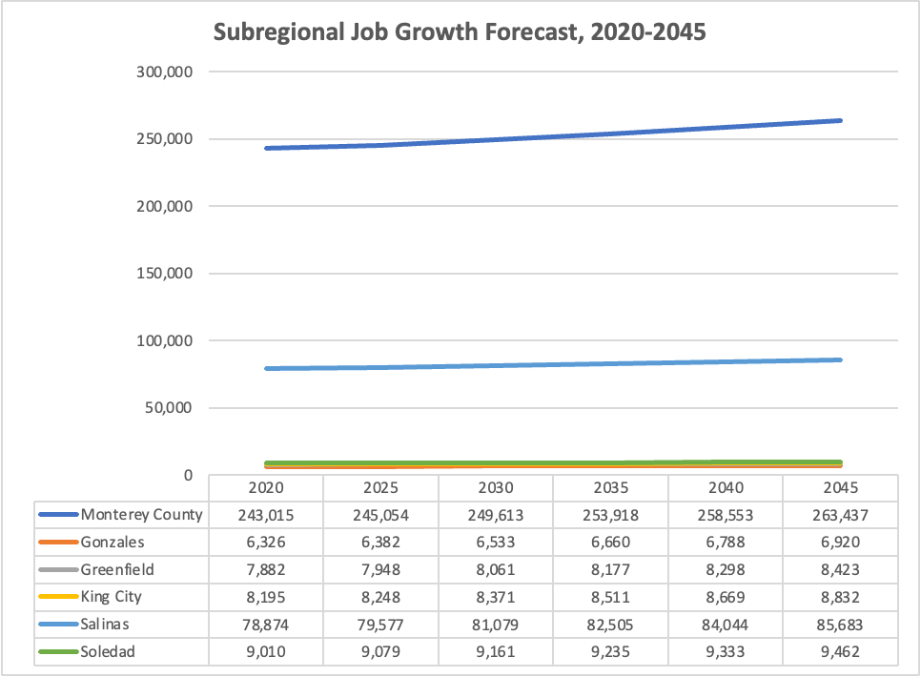
KEY FINDINGS - EXTERNAL SCAN
LABOR MARKET AND WORKFORCE NEEDS
Unemployment varies slightly across the three counties of Monterey, San Benito, and Santa Cruz. As of June 2023, the rate of unemployment (preliminary, not seasonally adjusted) was highest in San Benito at 5.8%, and lowest in Santa Cruz at 5.2%. Monterey County’s rate was 5.5%. (Employment Development Department, 2023)
Among five cities in the district, growth in the number of jobs from 2020-2045 is projected to be the highest for Salinas (5,170 jobs to a total of 85,683), which will in 2045 represent a job growth rate of 8.6%. Gonzales is forecasted to have the highest job growth rate at 9.4%, whereas Soledad is projected to have the lowest percentage increase at 3.6% and lowest growth in number of jobs over the 20-year period. (Association of Monterey Bay Area Governments Regional Growth Forecast, 2022)
Source: Association of Monterey Bay Area Governments Regional Growth Forecast, 2022.

Slide 16
KEY FINDINGS - EXTERNAL SCAN
WORKFORCE CHALLENGES AND OPPORTUNITIES
Job quality may be the biggest challenge, as Monterey County has a higher proportion of lower-paying, lower-skill jobs (61%) when compared with California overall (46%). This means that a greater share of the population struggles to pay for their everyday living expenses. In contrast, higher-paying, higher-skill jobs translate to greater opportunities for career advancement and upward mobility. These jobs are less represented in the county relative to the statewide average. The percentage of high quality jobs grew more swiftly than lower quality jobs in the state, whereas that percentage declined for the county. The majority of workers in the county (56%) have jobs that are at moderate risk of volatility due to automation. (Reimagination and Recovery After the Covid-19 Pandemic: State of the Workforce for Monterey County, 2021)
The greatest opportunities for workforce development may include the two industry clusters of aviation and agricultural technology. These clusters represent emerging and expanding career paths, and offer high-paying, high-skill jobs. Other growing industry segments offering high-paying, high-skill jobs may include cybersecurity and data protection, artificial intelligence, and product design and advanced manufacturing. (Reimagination and Recovery After the Covid-19 Pandemic: State of the Workforce for Monterey County, 2021)

Slide 17
KEY FINDINGS - INTERNAL SCAN

Slide 18
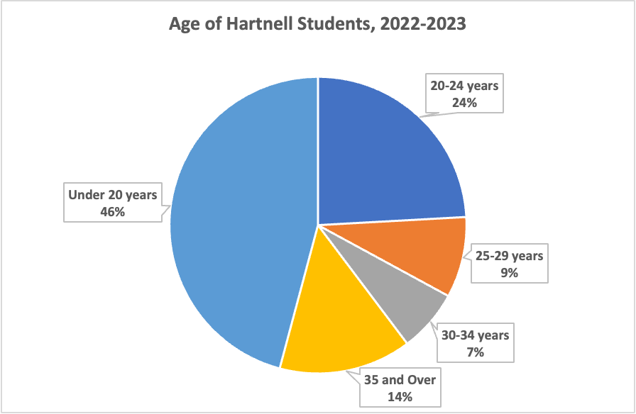
KEY FINDINGS - INTERNAL SCAN
STUDENT DEMOGRAPHICS
Gender. In 2022-2023, 54.6% of Hartnell College students identified as female, with 44.7% identifying as male. Those proportions have not changed significantly since 2018-2019.
Age. Approximately 70% of Hartnell students are under the age of 25. These age demographics have remained relatively unchanged since 2018-2019.
Race/Ethnicity. The majority of Hartnell students (80%) identify as Hispanic/Latino. Racial/ethnic student demographics have remained relatively stable from 2018-2019 to 2022-2023.
Pell eligibility. Approximately 36.5% of students meet income eligibility requirements for Pell grants. These proportions have remained stable since 2018-2019.

Slide 19
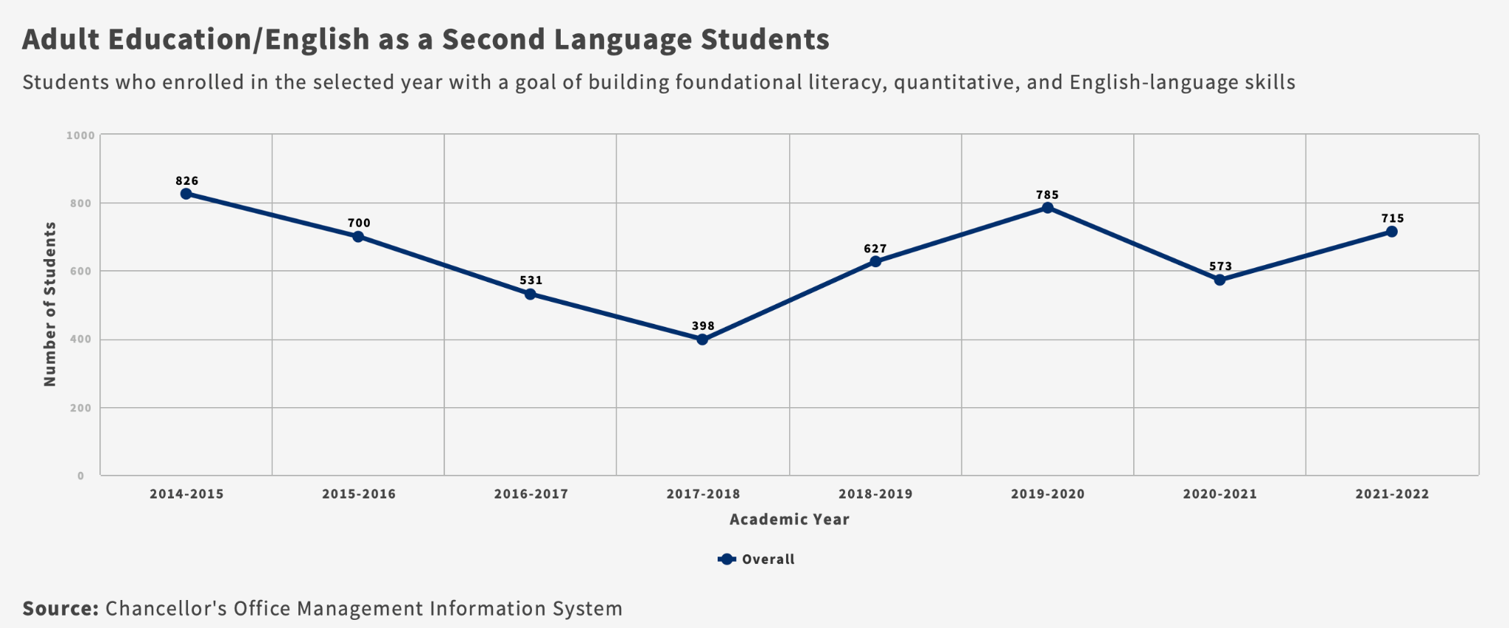
KEY FINDINGS - INTERNAL SCAN
STUDENT EDUCATIONAL GOALS
Degree, certificate, transfer. Between 2017-2018 and 2021-2022, the number of students who indicated a goal of earning an associate’s degree and/or transferring to a 4 year institution decreased by 10.3% (from 7,775 to 6,977). These declines are proportional to the college’s overall enrollment declines.
Job, career, skill development. The number of students indicating a goal of job, career, and/or skill development decreased sharply (71.3%) between 2017-2018 and 2020-2021 (from 6,559 to 1,884). This is likely due to the intentional scaling back of our participation in the South Bay Regional Public Safety Training Center programs, as well as the reduction of CTE course offerings due to the COVID-19 pandemic. In 2021-2022, 3,936 indicated a goal of job, career, and/or skill development.
Adult education/ESL. The number of adult education/ESL students increased by 79.7% between 2017-2018 (398 students) and 2021-2022 (715 students).

Slide 20
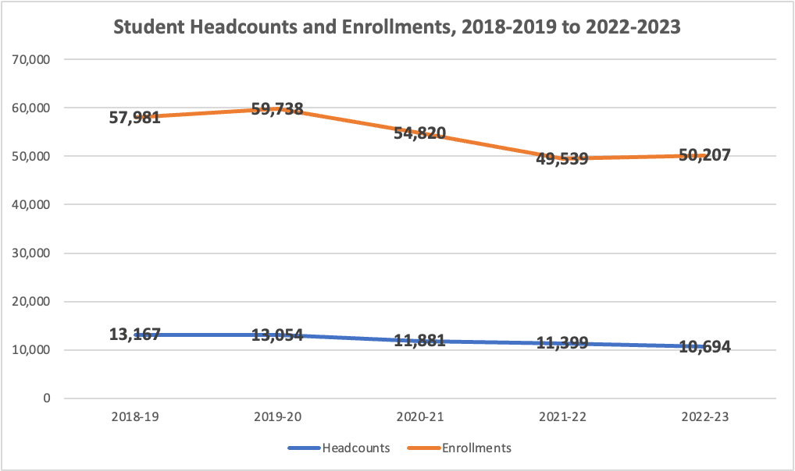
KEY FINDINGS - INTERNAL SCAN
STUDENT ENROLLMENT
Headcounts. Between 2018-2019 and 2022-2023, overall student headcounts decreased by 18.8% (from 13,167 to 10,694). The largest decreases occurred among continuing students (21.2% decrease), students between the ages of 20 and 24 (27.6% decrease), and students who identify as White (36.8% decrease) or Asian (26.9% decrease). Dual enrollment students increased slightly by 1.4%. The number of first-time Salinas Valley Promise students increased by 55.2% between Fall 2019 and Fall 2022, from 620 to 962 students.
Enrollments. Overall enrollments decreased by 13.4% between 2018-2019 and 2022-2023 (from 57,981 to 50,207).

Slide 21
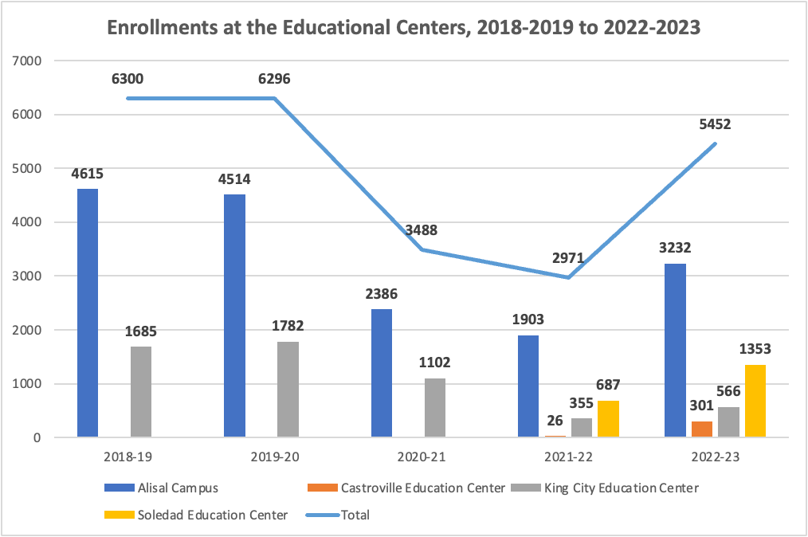
KEY FINDINGS - INTERNAL SCAN
STUDENT ENROLLMENT
Educational centers. Between 2018-2019 and 2022-2023, enrollments at the educational centers (combined) decreased by 13.5% (from 6,300 to 5,452). This is despite the fact that in 2018-2019, two educational centers existed (Alisal and King City), and 2022-2023 saw the addition of two additional centers (Castroville and Soledad). Enrollments at the Alisal center decreased by 30%, and enrollments at King City decreased by 66.4%. When 2022-2023 enrollments at the Soledad and King City centers are combined (4,585), there was less than a 1% decrease compared to King City enrollments in 2018-2019 (4,615).
Distance education. Face-to-face enrollments declined by 52.8% (from 46,445 to 21,926) between 2018-2019 and 2022-2023. Online enrollments, in contrast, increased by 198.1% (from 7,012 to 20,905). Hybrid course enrollments increased by 38.6% (from 4,524 to 6,272).
Inmate education. Over the last five years, inmate enrollments increased by 21.6% (from 928 to 1,128). The largest enrollment increases were at Salinas Valley State Prison (from 431 in 2018-2019 to 685 in 2022-2023).

Slide 22
KEY FINDINGS - INTERNAL SCAN
PROGRESS AND MOMENTUM
Full-time vs. part-time. The majority of Hartnell students are enrolled part-time. In Fall 2022, 37.6% were enrolled full-time, and 62.4% were enrolled part-time, with little fluctuation over the last five years. Interestingly, a higher proportion of students are remaining enrolled full-time over the full academic year (18.45% in 2022-2023, compared to 16.37% in 2017-2018).
Unit accumulation. In 2021-2022, Hartnell students earning an associate’s degree accumulated an average of 82 units, compared to 89 units in 2017-2018.
Completion of gateway courses. In 2021-2022, 17% of students completed both transfer-level math and English courses in their first year (525 out of 3,097). Twenty-two percent (680) completed transfer-level math only, and 32% (983) completed transfer-level English only. This is a significant improvement compared to the 2017-2018 academic year; only 6% completed both transfer-level math and English in their first year (222 out of 3,444), 10% (348) completed only transfer-level math, and 17% (602) completed only transfer-level English.
Completion of Transfer-Level Math and English in the First Year

Slide 23
KEY FINDINGS - INTERNAL SCAN
PROGRESS AND MOMENTUM
Course retention. Overall retention rates improved from 85.6% in 2018-2019 to 88.6% in 2022-2023. Retention rates improved for all racial/ethnic groups except American Indian/Indigenous students (from 82.7% to 77.8%) and Black/African American students (from 84.2% to 82.8%). These are also the two groups that show disproportionate impact, compared to the overall retention rate.
Fall-to-spring persistence. Persistence rates decreased from 70.2% in 2018-2019 to a low of 60.5% in 2021-2022, but climbed to 68.1% in 2022-2023. The following demographic trends were noted:
Fall-to-spring persistence rates decreased from 2018-2019 to 2022-2023 by more than 3 percentage points among Native American/Indigenous, Asian, Black/African American, and multi-race students.
Students who are 25 and older have the lowest persistence rates of any age group; in 2022-2023, 54.3% of students 25-29 years old, 54.9% of students 30-34 years old, and 57.1% of students 35 and older persisted into the spring semester.
Among first time in college (FTIC) students, persistence rates decreased from 2018-2019 to 2021-2022 (66.8% to 57.5%), but recovered by 2022-2023 (67.8%).
This was not the case for continuing students; persistence rates declined from 71.1% in 2018-2019 to 61.4% in 2021-2022, and while they improved to 68.2% by 2022-2023, they have not yet reached 2018-2019 levels.

Slide 24
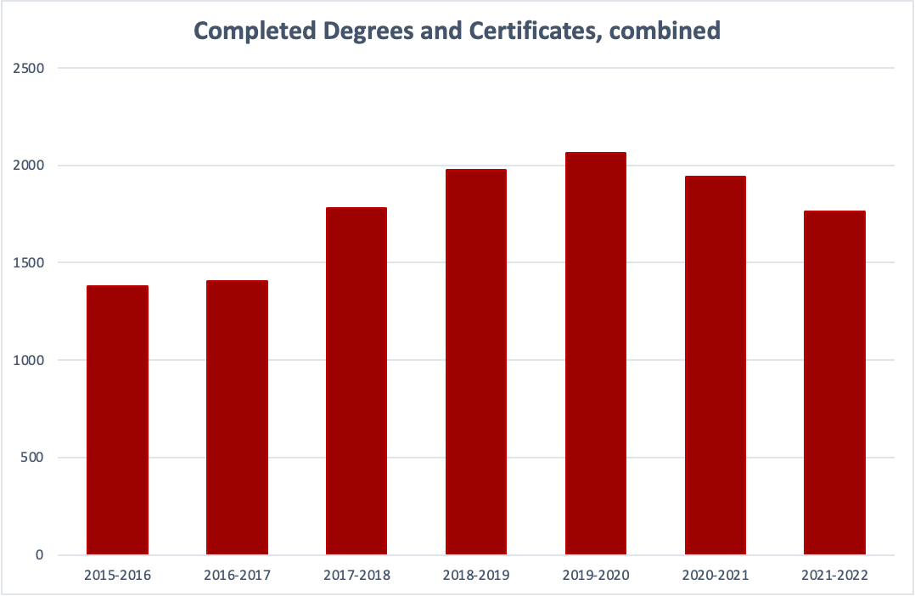
KEY FINDINGS - INTERNAL SCAN
STUDENT ACHIEVEMENT
Course success. Overall course success rates increased from 73.5% in 2018-2019 to 74.7% in 2022-2023. Success rates improved or remained within 3 percentage points for all racial/ethnic groups over that five-year period except for Black/African American students (from 71.8% in 2018-2019 to 67.1% in 2022-2023). Male student success rates improved from 71.3% in 2018-2019 to 75.2% in 2022-2023, while female student success rates decreased slightly (from 75.2% to 74.3%).
Degree and certificate completion. The number of earned degrees and certificates peaked in 2019-2020 and has since declined. However, when declining enrollments are taken into account, the percentage of students earning a credential has increased. In 2021-2022, the completion rate was 17.9%, compared to 16.7% in 2019-2020.
Transfers to UC/CSU. Over the last five years, transfers to UC/CSU have increased by 22% (from 675 in 2016-2017 to 825 in 2021-2022).

Slide 25
KEY FINDINGS - SWOT ANALYSIS

Slide 26
KEY FINDINGS - SWOT ANALYSIS
A SWOT analysis was conducted in Fall 2022 with the Academic Senate, Associated Students of Hartnell College (ASHC), classified professionals, and senior leadership team members.
Nine key themes emerged from this analysis.
THEME 1: UNDERSTANDING AND PROACTIVELY REACHING OUR STUDENTS
Leveraging status as a Hispanic Serving Institution, Caring Campus college, and Salinas Valley Promise
Engaging in effective communication with students, including the website
Offering services, including counseling, equitably and at scale
Enhancing personal connections that were disrupted during COVID
Addressing basic needs, including food insecurity, housing, transportation issues, and internet access.
Increased student mental health issues
Safety and security of undocumented students
Challenges students have balancing school and family obligations, work, and seasonal employment/migration
Environmental disasters increasing with climate change

Slide 27
KEY FINDINGS - SWOT ANALYSIS
THEME 2: ENROLLMENT MANAGEMENT
Strong enrollment potential with adult and non-traditional student populations
Challenges throughout the student educational journey, including cumbersome onboarding processes, low retention and persistence, and high number of units accumulated
Demand for fully online courses and programs
Need for part-time student pathways
Educational centers with updated facilities located in areas with low college-going rates
Competition from online proprietary colleges and nontraditional education providers
THEME 3: ADAPTABILITY OF ORGANIZATIONAL CULTURE
Participation in Achieving the Dream
Commitment across employee groups to serve students
Resistance to change, combined with a culture of reactivity
Need for training and professional development focusing on student success initiatives
Challenges associated with employee turnover
Outdated technology combined with rapid technological shifts
Problematic relations among and within some groups and across organizational levels
Challenges attracting high caliber employees, given salaries and limited remote work options
Increased safety and security concerns

Slide 28
KEY FINDINGS - SWOT ANALYSIS
THEME 4: INTEGRATION OF COLLEGE OPERATIONS
Cumbersome, inefficient, and outdated processes
Poor communication across the district
Lack of integration of services across student affairs and academic affairs
Limited cross-training of staff
Data utilized in the strategic planning process, yet not widely available for day-to-day analysis and decision-making
THEME 5: FISCAL HEALTH
Fiscally strong institution with respect to donations, grants, and reserves
Hartnell College Foundation is strong
Lack of integration of multiple funding streams into a comprehensive model of student success
Cost associated with many programs serving small numbers of students
Cost of increased facilities footprint (2 additional centers) while demand for online/hybrid courses is growing
Some programs have low enrollment and completion rates
State funding concerns - state budget uncertainty, SCFF hold harmless period ending, SCFF focus on student success but not on all populations

Slide 29
KEY FINDINGS - SWOT ANALYSIS
THEME 6: LINK TO COMMUNITIES IN SERVICE AREA
Strong connection to community with solid community relationships
THEME 7: LINK TO INDUSTRY AND EMPLOYERS IN SERVICE AREA
Responsive to industry needs, particularly in STEM, health care, and agriculture
Lacking comprehensive approach to student employment and career placement
High demand for jobs in the trades
Creation of additional internship and experiential learning opportunities
Shifting workforce needs in the new economy
THEME 8: EDUCATIONAL PIPELINE FROM K-12 TO HARTNELL
Strong outreach to local high schools
Increase in high school dual enrollment program
Leakage of students from elementary to high school levels in Monterey County
Inadequate K-12 preparation of students for college
THEME 9: EDUCATIONAL PIPELINE FROM HARTNELL TO 4-YEAR INSTITUTIONS
Strong partnership with CSUMB
Lacking comprehensive approach to student transfer
Need to strengthen and increase partnerships with other regional 4-year institutions

Slide 30
QUESTIONS?
COMMENTS?

